Slide 1
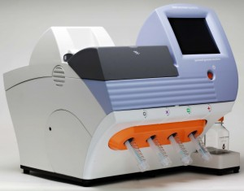
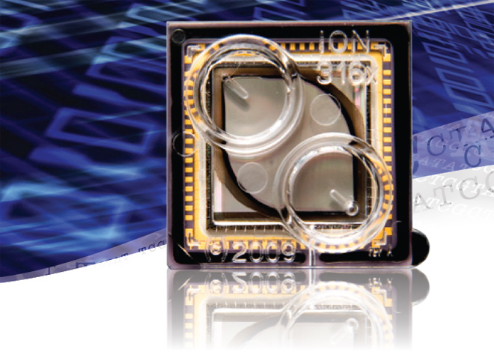
“BIG DATA”
from RNA-Seq Experiments

Slide 2
Significance of RNA-Seq Approaches
Reveals which genes are expressed and the levels at which they are expressed; a technique for the “post-genomic” era
Of huge importance for biomedicine, toxicology, environmental biology, and basic research
“Whole Genome Analysis: When Each Patient is a Big Data Problem”
“ … spectacular opportunities and immense challenges presented by the dawning era of "Big Data" in biomedical research … (NIH call for proposals)

Slide 3
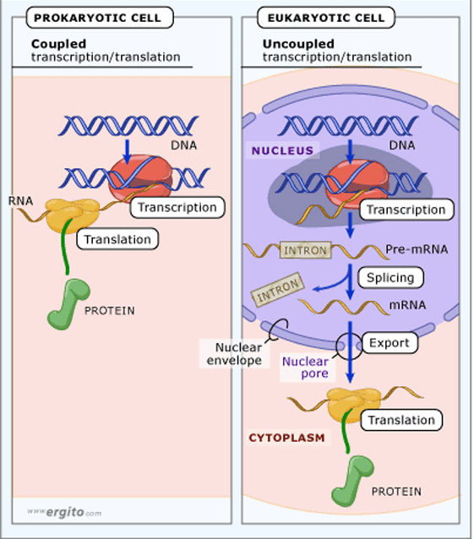
Review:
“Central Dogma of Molecular Biology”
DNA -> RNA -> Protein
(Way more complex!)
http://biology200.gsu.edu/houghton/4595%20'04/figures/Lecture1/dogma.gif

Slide 4
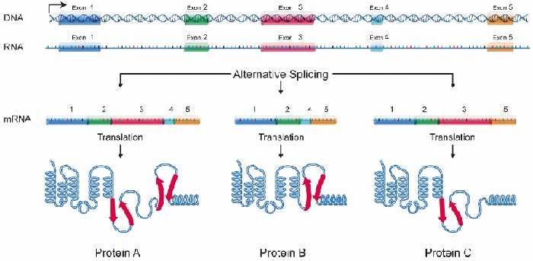
Alternative Splicing: Splice Variants or Isoforms
http://www.nature.com/scitable/content/ne0000/ne0000/ne0000/ne0000/95777/DNA_alternative_splicing_LARGE_2.jpg

Slide 5
WHAT IS BIG DATA ???
Gartner. In 2001:
Three-fold definition encompassing the “three Vs”: Volume, Velocity and Variety.
sometimes includes a fourth V: veracity, to cover questions of trust and uncertainty.
2. Oracle. Big data is the derivation of
value from traditional relational database-driven business decision making,
augmented with new sources of unstructured data.
3. Intel: a median of 300 terabytes of data a week.
4. Microsoft. applying
serious computing power— machine learning and artificial intelligence—
To massive and often complex sets of information.”
5. The Method for an Integrated Knowledge Environment : not a function of the size of a
data set but its complexity; high degree of permutations and interactions within a
data set.
6. NIST : data which exceed(s) the capacity or capability of current
or conventional methods and systems.
http://www.technologyreview.com/view/519851/the-big-data-conundrum-how-to-define-it/

Slide 6
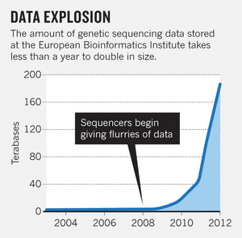
BIG DATA in BIOLOGY (Sequencing) :
A BIG Problem
~150 GB per human genome/transcriptome
“The Big Challenges of Big Data”:
http://www.nature.com/nature/journal/v498/n7453/full/498255a.html

Slide 7
The “Science Question” in Our Lab: How do cells in the nervous system acquire and identity …
…. and maintain an identity on the face of a
changing environment?

Slide 8
Genetic Perturbations: Embryos “compensate” following overexpression of Notch signaling pathway !
Neural beta-tubulin expression at different stages
Notes:
Label the scalebars. Expand the figure. Use space.

Slide 9
Physical Perturbations
Tailbud Embryo
Tadpole Embryo

Slide 10
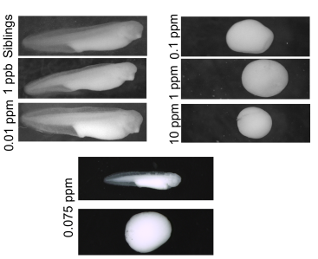
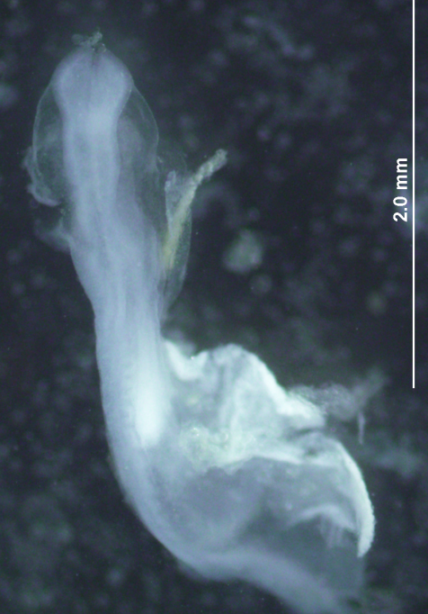
Environmental Perturbations
Hg-treated Xenopus embryos
A new developmental model
system: Zebra Finch Embryos

Slide 11
We use ION TORRENT PGM (Personal Genome
Machine) technology
Isolate RNA → Isolate mRNA
Make Library
Prepare Template
Sequence
Analyze Data
Interpret Data

Slide 12
Isolate RNA
Library Preparation

Slide 13
3. Template Preparation
http://sunnybrook.ca/uploads/PGM_flowchart_web2.png

Slide 14
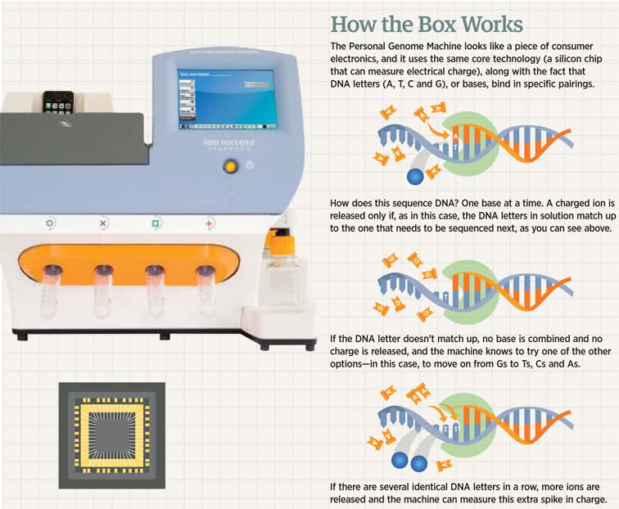
4. Sequencing

Slide 15
Sequencing (continued)

Slide 16
5. Data Analysis:
Align reads to genome/transcriptome
Identify expressed genes/isoforms
(transcriptome reconstruction)
c. Estimation of abundance
d. Differential expression analysis
http://www.informaticsblogs.com/author/rna-seq-blog/page/7/

Slide 17
Data Analysis: continued
Problems: repetitive sequences; which gene model to use; poor
annotations/gene models; novel isoforms; intronic sequence;
ambiguous reads; how to normalize!!!
Review article: Garber et al. (2011). “Computational methods for transcriptome
Annotation and quantification using RNA-seq,” Nature Methods, 8: 469-477.

Slide 18
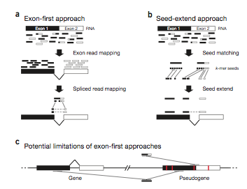
a. Alignment of Reads to Genome

Slide 19
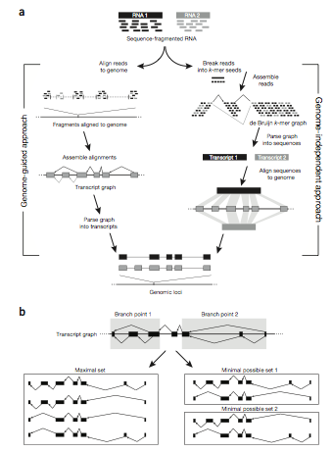
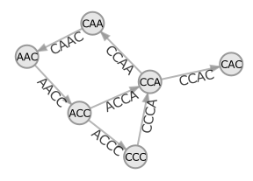
b. Transcriptome Reconstruction Methods
A simple de Bruijn graph with k = 4. The graph corresponds to a series of short reads for the consensus sequence "ACCCAACCAC“;
Assemblers must identify an Eulerian path through this graph.
http://gcat.davidson.edu/phast/debruijn.html

Slide 20
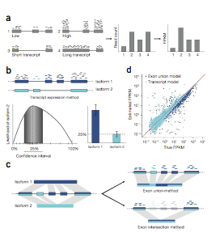
Gene Quantification
(appropriate normalization a huge issue)

Slide 21
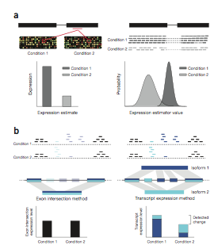
d. Differential Expression Analysis
Dealing with the “n” problem in RNA-seq – these data represent ONE experiment.

Slide 22
6. Interpret Data !
Perhaps the biggest challenge ….
Grouping the expressed genes to produce
biological meaningful data and
visualization of the data

Slide 23
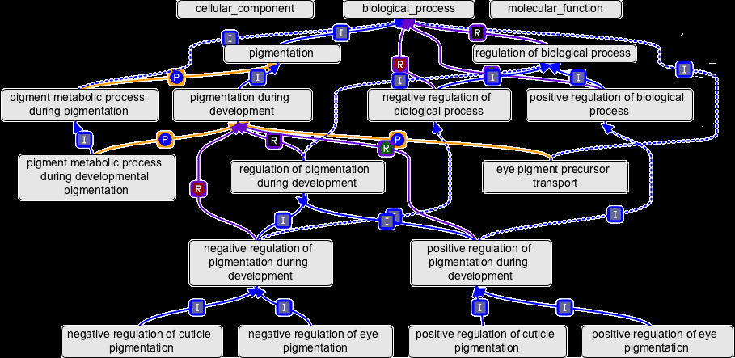
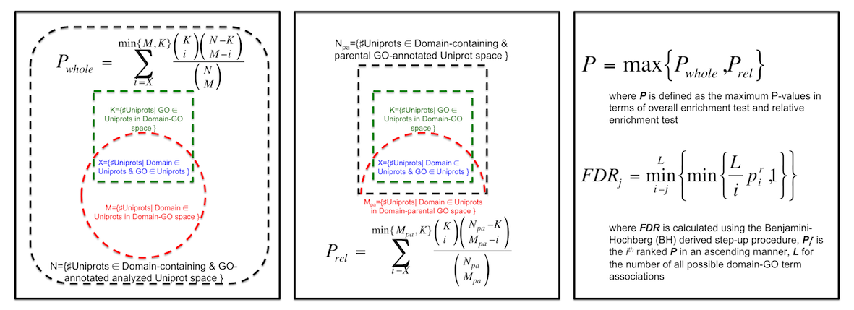
Gene Ontology (GO Terms): Identifying Function
Domain-centric Gene Ontology (supfam.cs.bris.ac.uk )

Slide 24
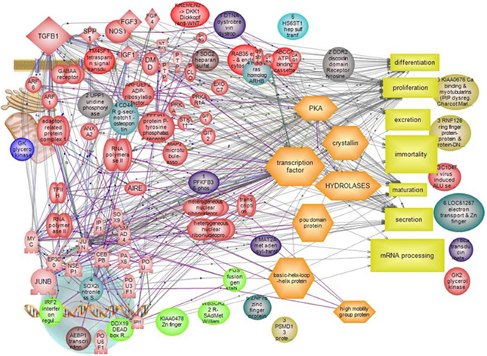
Pathway Analysis -> Modeling Data -> Making & Testing
Predictions -> Heuristic Models
https://www.google.com/search?q=pathway+analysis&client=firefox-a&hs=N6d&rls=org.

Slide 25
“ … spectacular opportunities and immense challenges …
presented by the dawning era of "Big Data" in biomedical
research … “
Sequencing platforms very different
Substantial difference among different methods for detecting DE
Often poor gene models – continually changing
ULTRA-high dimensionality (unknown) – extremely low “n”
Poor GO (gene ontology) assignments
Multiclass/multiscale comparisons /modeling

Slide 26
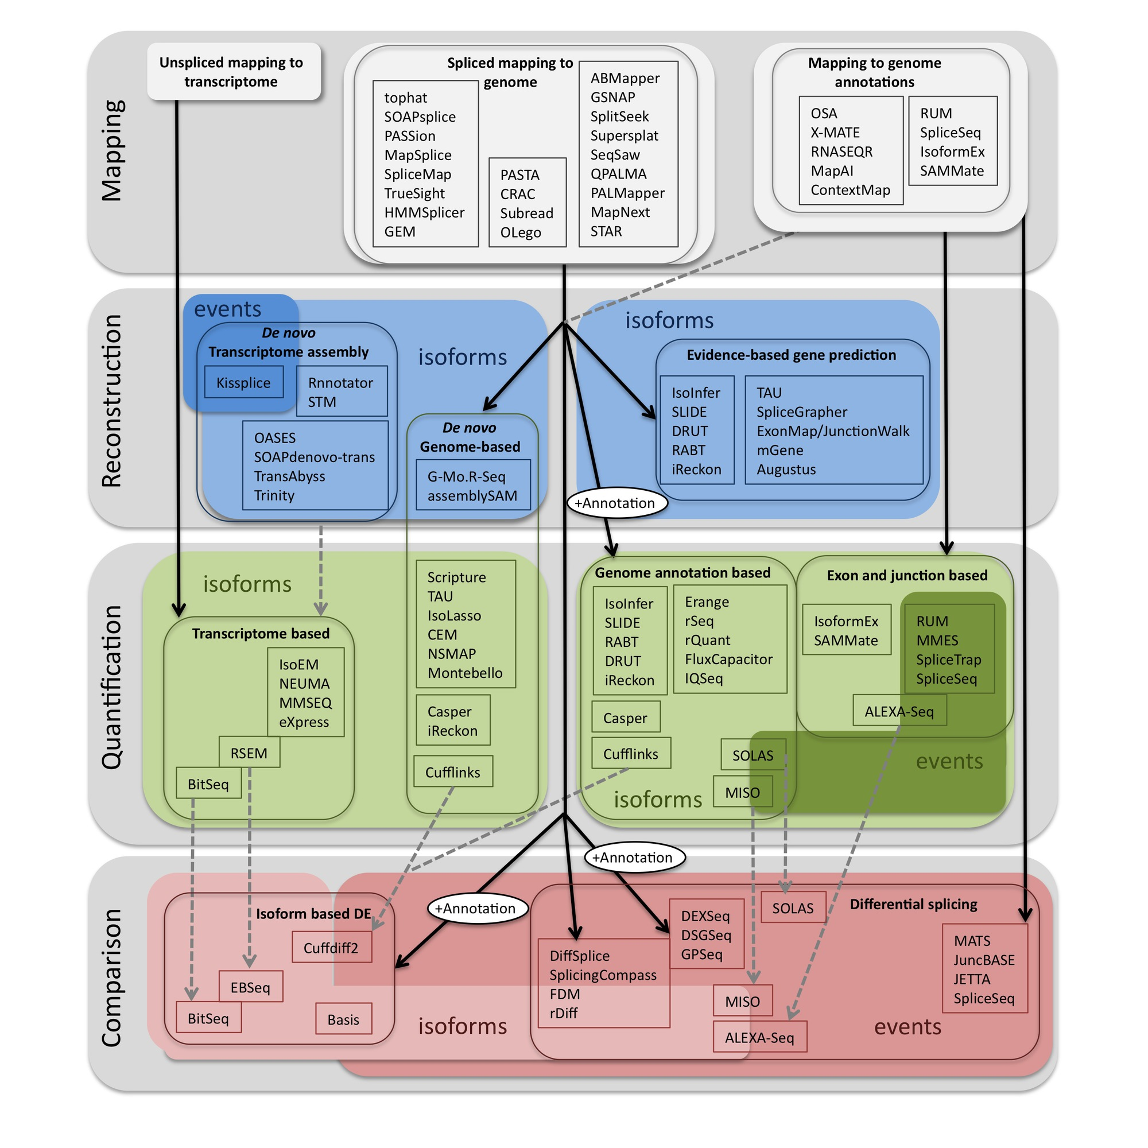
Commonly Used Programs …
http://www.rna-seqblog.com/methods-to-study-splicing-from-rna-seq/

